Slide 1
Root Finding Method: Bisection Method
Group 15
Berces, Arthur William
Damasco, Vinard James
Espiritu, Kyle Gabrielle

Slide 2
Definition
The Bisection method, also known as interval halving method, is an approximation method used to find the roots of a given equation by repeatedly dividing the interval by half per iteration determining where the function converges.

Slide 3
Purpose
The Bisection method is used to find the root of an equation using a given function. It is made to be simple to execute with a high convergence rate at the cost of efficiency.

Slide 4
What is the program all about?
The program is a calculator that uses bisection as its root finding method. It allows the entering of a function, initial start and end points, and the degree of error. Various polynomial functions may be used up to a certain degree and the iterations used for approximating the root caps out at 50.

Slide 5
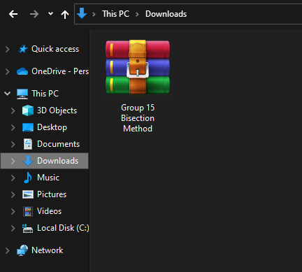
How to execute the program?
Download the archived .rar file we have uploaded in Blackboard and save it in your Downloads directory

Slide 6
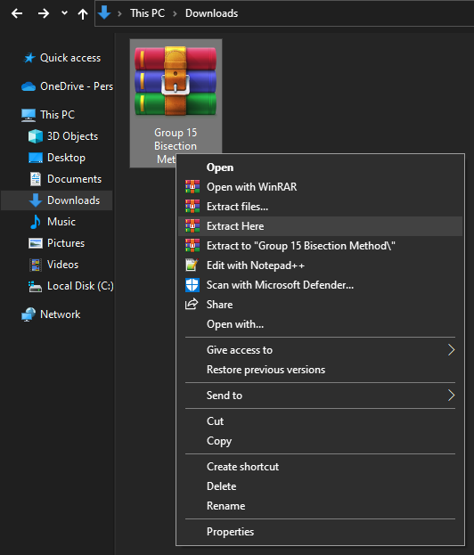
How to execute the program?
Once downloaded, extract its contents in the same directory

Slide 7
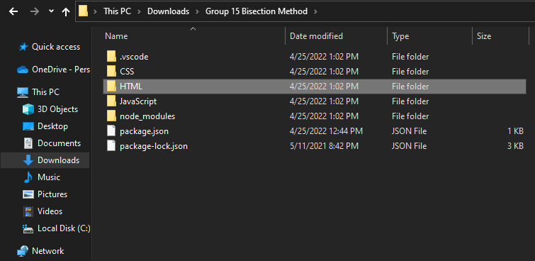
How to execute the program?
Once extracted, open the folder named “HTLM”

Slide 8
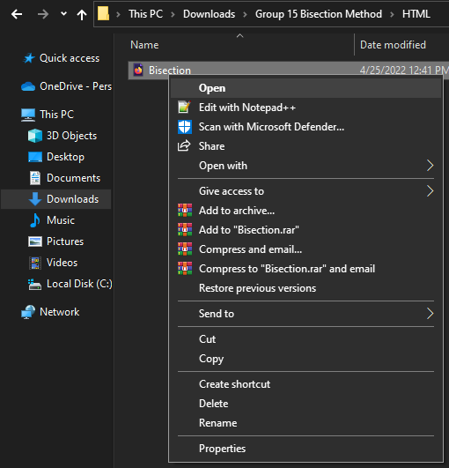
How to execute the program?
Once inside the folder named “HTML”, double-click or right-click and open the file named “Bisection”

Slide 9
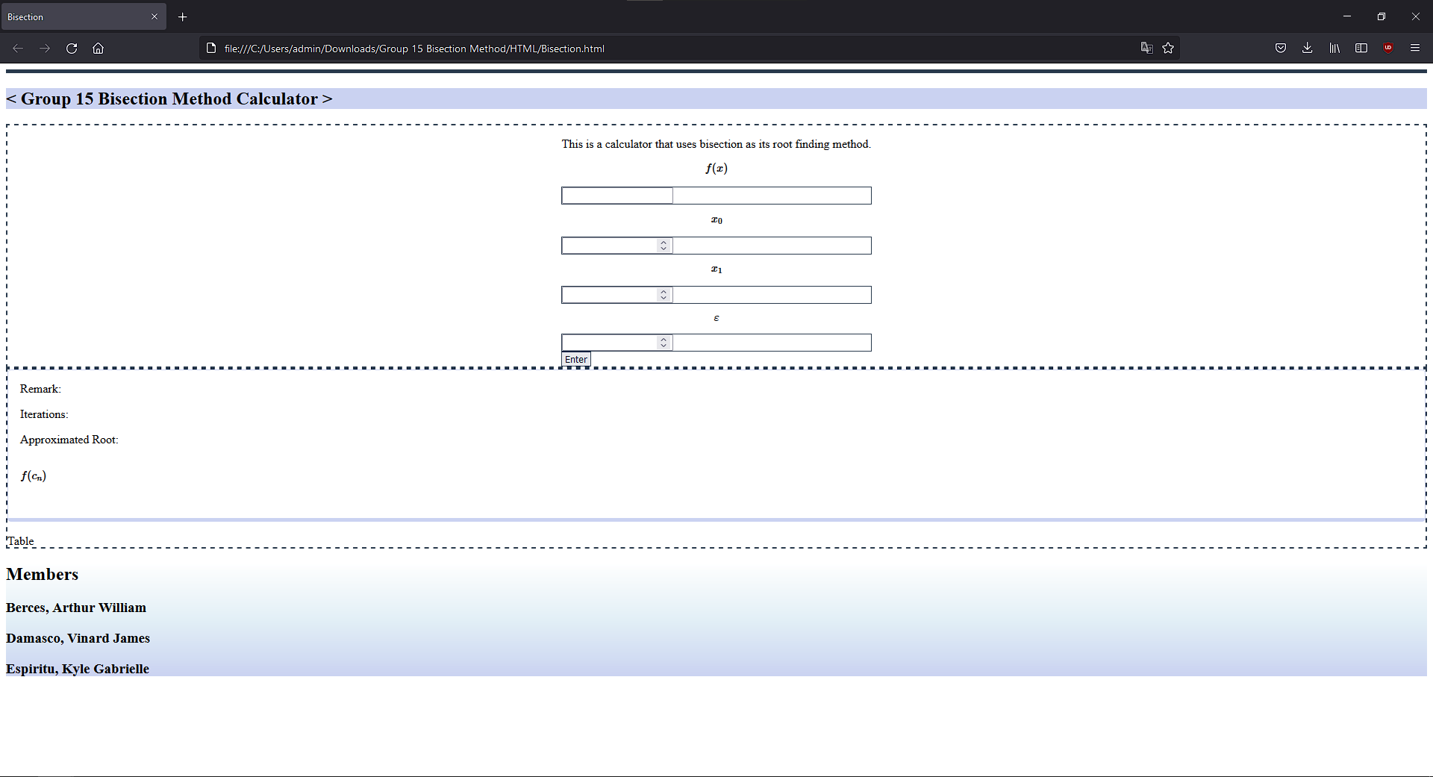
How to execute the program?
You can now use our program

Slide 10
Thank You

